Slide 1
Cloud Automation
Saintcon 2023
David Thurm
@PacketMonster
Notes:
A terraform provider is a plugin that allows terraform to interact with a cloud provider. They also have plugins for Vsphere, SaaS, and other APIs.
We grab this section from the terraform providers webpage. Just search terraform providers and click on azure.
Sometimes the version will change and may change the whole syntax and break your stuff. It happened to me while I was writing this presentation. The way security groups are done changed on me.
An example of a Feature is “prevent_deletion_if_contains_resources = false” This allows me to delete a resource group even if it has stuff in it. Sometimes a hard disk doesn’t get deleted because I configured the VM wrong.

Slide 2
Introduction
Cyber Security Architect, Accenture Federal Services
Cloud Smart Subject Matter Expert (SME)
Zero Trust SME for the Department of Energy
Zero Trust
Automation and Orchestration Foundation
Identity Pillar
** I AM NOT A DEVELOPER **
Notes:
A terraform provider is a plugin that allows terraform to interact with a cloud provider. They also have plugins for Vsphere, SaaS, and other APIs.
We grab this section from the terraform providers webpage. Just search terraform providers and click on azure.
Sometimes the version will change and may change the whole syntax and break your stuff. It happened to me while I was writing this presentation. The way security groups are done changed on me.
An example of a Feature is “prevent_deletion_if_contains_resources = false” This allows me to delete a resource group even if it has stuff in it. Sometimes a hard disk doesn’t get deleted because I configured the VM wrong.

Slide 3
Agenda – Intro to Terraform
I will walk through the code and then hands on.
We will create, modify, and destroy workloads.
You will be able to go back into your lab and deploy a server instance today.
All code is in the Github repository.
We have 4 hours, so we have some bonus moderate to advanced content as well.
Notes:
A terraform provider is a plugin that allows terraform to interact with a cloud provider. They also have plugins for Vsphere, SaaS, and other APIs.
We grab this section from the terraform providers webpage. Just search terraform providers and click on azure.
Sometimes the version will change and may change the whole syntax and break your stuff. It happened to me while I was writing this presentation. The way security groups are done changed on me.
An example of a Feature is “prevent_deletion_if_contains_resources = false” This allows me to delete a resource group even if it has stuff in it. Sometimes a hard disk doesn’t get deleted because I configured the VM wrong.

Slide 4


AWS Account Setup
Notes:
A terraform provider is a plugin that allows terraform to interact with a cloud provider. They also have plugins for Vsphere, SaaS, and other APIs.
We grab this section from the terraform providers webpage. Just search terraform providers and click on azure.
Sometimes the version will change and may change the whole syntax and break your stuff. It happened to me while I was writing this presentation. The way security groups are done changed on me.
An example of a Feature is “prevent_deletion_if_contains_resources = false” This allows me to delete a resource group even if it has stuff in it. Sometimes a hard disk doesn’t get deleted because I configured the VM wrong.

Slide 5

AWS GUI
The Slow Way with Love and Tenderness.

Slide 6
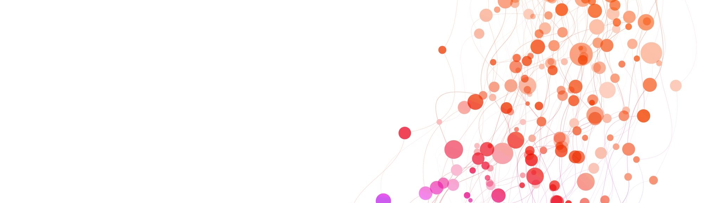
Demo/Hands On
GUI Configuration
Notes:
A terraform provider is a plugin that allows terraform to interact with a cloud provider. They also have plugins for Vsphere, SaaS, and other APIs.
We grab this section from the terraform providers webpage. Just search terraform providers and click on azure.
Sometimes the version will change and may change the whole syntax and break your stuff. It happened to me while I was writing this presentation. The way security groups are done changed on me.
An example of a Feature is “prevent_deletion_if_contains_resources = false” This allows me to delete a resource group even if it has stuff in it. Sometimes a hard disk doesn’t get deleted because I configured the VM wrong.

Slide 7
GitHub Repo
Repo Location
https://github.com/towerindustries/training_terraform_intro_aws
Step by Step with Pictures
Intro_to_terraform_aws.pdf
Slides
Intro_to_terraform_aws.pptx

Slide 8

Intro to Terraform
Servers have no feelings
Notes:
A terraform provider is a plugin that allows terraform to interact with a cloud provider. They also have plugins for Vsphere, SaaS, and other APIs.
We grab this section from the terraform providers webpage. Just search terraform providers and click on azure.
Sometimes the version will change and may change the whole syntax and break your stuff. It happened to me while I was writing this presentation. The way security groups are done changed on me.
An example of a Feature is “prevent_deletion_if_contains_resources = false” This allows me to delete a resource group even if it has stuff in it. Sometimes a hard disk doesn’t get deleted because I configured the VM wrong.

Slide 9
What is Terraform
Cloud Automation
Deploy your networks, Access Control Lists, Firewalls, WAFs, Servers, etc
Saves hours of your life.
Repeatable processes that are code reviewed.
Immutable Infrastructure (Zero Trust)
Fancy talk for you don’t patch you Nuke from orbit and redeploy clean instances (Servers).
Secure by Default
Pairs well with Ansible and Salt

Slide 10

Environment Setup
Improving your quality of life

Slide 11

Visual Studio Code
Your new best friend – CoPilot is your side chick

Slide 12
Hands on Lab
VScode – Installation and Configuration

Slide 13

AWS Cloud Console
Keeping it Painless

Slide 14

Terraform

Slide 15
Hands on Lab
Terraform Install

Slide 16
Download Terraform
mkdir code
cd code
wget https://releases.hashicorp.com/terraform/1.5.7/terraform_1.5.7_linux_amd64.zip
unzip terraform_1.5.7_linux_amd64.zip
rm terraform_1.5.7_linux_amd64.zip

Slide 17

Github
The Stupid Simple Version

Slide 18
Git - All you need to know
GitHub is not Git
Git is the tool for syncing your repo’s to and from GitHub.
Why GitHub and not AWS CodeCommit?
Clone the Repo
git clone https://<repo name>
Updating Repo on github
git add .
git commit –m “my first commit”
git push
git pull

Slide 19
Authentication Login
Web Console
IAM > users > “your-username” > Security Credentials
Scroll down
Create Access Keys
Command Line Interface
Copy access key and secret key to a file.
Cloud Shell
~/.aws/credentials
[default]
aws_access_key_id =0EnvoxK7I07QG5pQBeyr0
aws_secret_access_key =YnC5ymQMT5L9lb4OuGYIOSCrJhX8aRKC5MQzf5kd4
aws configure
** This is not a recommended way to login.**
*** This Secret is a 41 random number that is not real ***

Slide 20
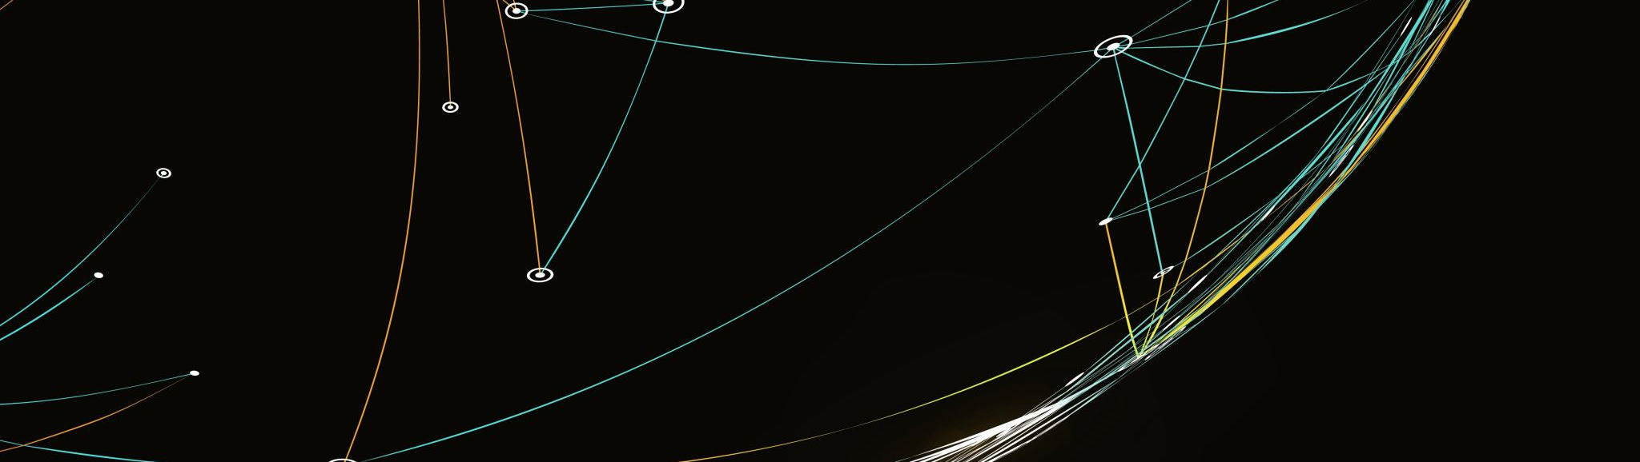
Terraform Basics

Slide 21
File and Directory Structure
Minimum Files
Main.tf
README.md (Optional)
Directories/Folder
/
Notes:
A terraform provider is a plugin that allows terraform to interact with a cloud provider. They also have plugins for Vsphere, SaaS, and other APIs.
We grab this section from the terraform providers webpage. Just search terraform providers and click on azure.
Sometimes the version will change and may change the whole syntax and break your stuff. It happened to me while I was writing this presentation. The way security groups are done changed on me.
An example of a Feature is “prevent_deletion_if_contains_resources = false” This allows me to delete a resource group even if it has stuff in it. Sometimes a hard disk doesn’t get deleted because I configured the VM wrong.

Slide 22

Key Ingredients / Requirements
provider
aws_vpc
aws_internet_gateway
aws_subnet
aws_route_table
aws_route_table_association
aws_security_group
aws_instance
Notes:
This is the only meme because I had too much stuff on each slide.
My wife is a pastry chef, so I look at this as the individual ingredients you need to make a server deployment.

Slide 23
providers
terraform {
required_providers {
aws = {
source = "hashicorp/aws"
version = "5.17.0"
}
}
required_version = "~> 1.5.7"
}
provider "aws" {
}
Notes:
A terraform provider is a plugin that allows terraform to interact with a cloud provider. They also have plugins for Vsphere, SaaS, and other APIs.
We grab this section from the terraform providers webpage. Just search terraform providers and click on azure.
Sometimes the version will change and may change the whole syntax and break your stuff. It happened to me while I was writing this presentation. The way security groups are done changed on me.
An example of a Feature is “prevent_deletion_if_contains_resources = false” This allows me to delete a resource group even if it has stuff in it. Sometimes a hard disk doesn’t get deleted because I configured the VM wrong.

Slide 24
aws_vpc
resource "aws_vpc" "dev-environment" {
cidr_block = "172.17.0.0/16"
instance_tenancy = "default"
}
Notes:
A terraform provider is a plugin that allows terraform to interact with a cloud provider. They also have plugins for Vsphere, SaaS, and other APIs.
We grab this section from the terraform providers webpage. Just search terraform providers and click on azure.
Sometimes the version will change and may change the whole syntax and break your stuff. It happened to me while I was writing this presentation. The way security groups are done changed on me.
An example of a Feature is “prevent_deletion_if_contains_resources = false” This allows me to delete a resource group even if it has stuff in it. Sometimes a hard disk doesn’t get deleted because I configured the VM wrong.

Slide 25
aws_internet_gateway
resource "aws_vpc" "dev-environment" {
cidr_block = "172.17.0.0/16"
instance_tenancy = "default"
}
Notes:
A terraform provider is a plugin that allows terraform to interact with a cloud provider. They also have plugins for Vsphere, SaaS, and other APIs.
We grab this section from the terraform providers webpage. Just search terraform providers and click on azure.
Sometimes the version will change and may change the whole syntax and break your stuff. It happened to me while I was writing this presentation. The way security groups are done changed on me.
An example of a Feature is “prevent_deletion_if_contains_resources = false” This allows me to delete a resource group even if it has stuff in it. Sometimes a hard disk doesn’t get deleted because I configured the VM wrong.

Slide 26
aws_subnet
resource "aws_subnet" "dev-subnet" {
vpc_id = aws_vpc.dev-environment.id
cidr_block = "172.17.0.0/24"
}
Notes:
A terraform provider is a plugin that allows terraform to interact with a cloud provider. They also have plugins for Vsphere, SaaS, and other APIs.
We grab this section from the terraform providers webpage. Just search terraform providers and click on azure.
Sometimes the version will change and may change the whole syntax and break your stuff. It happened to me while I was writing this presentation. The way security groups are done changed on me.
An example of a Feature is “prevent_deletion_if_contains_resources = false” This allows me to delete a resource group even if it has stuff in it. Sometimes a hard disk doesn’t get deleted because I configured the VM wrong.

Slide 27
aws_route_table
resource "aws_route_table" "dev-routetable" {
vpc_id = aws_vpc.dev-environment.id
route {
cidr_block = "0.0.0.0/0"
gateway_id = aws_internet_gateway.dev-igw.id
}
}
Notes:
A terraform provider is a plugin that allows terraform to interact with a cloud provider. They also have plugins for Vsphere, SaaS, and other APIs.
We grab this section from the terraform providers webpage. Just search terraform providers and click on azure.
Sometimes the version will change and may change the whole syntax and break your stuff. It happened to me while I was writing this presentation. The way security groups are done changed on me.
An example of a Feature is “prevent_deletion_if_contains_resources = false” This allows me to delete a resource group even if it has stuff in it. Sometimes a hard disk doesn’t get deleted because I configured the VM wrong.

Slide 28
aws_route_table_association
resource "aws_route_table_association" "dev-routetable-assoc" {
subnet_id = aws_subnet.dev-subnet.id
route_table_id = aws_route_table.dev-routetable.id
}
Notes:
A terraform provider is a plugin that allows terraform to interact with a cloud provider. They also have plugins for Vsphere, SaaS, and other APIs.
We grab this section from the terraform providers webpage. Just search terraform providers and click on azure.
Sometimes the version will change and may change the whole syntax and break your stuff. It happened to me while I was writing this presentation. The way security groups are done changed on me.
An example of a Feature is “prevent_deletion_if_contains_resources = false” This allows me to delete a resource group even if it has stuff in it. Sometimes a hard disk doesn’t get deleted because I configured the VM wrong.

Slide 29
aws_security_group
resource "aws_security_group" "sg_example" {
name_prefix = "dev-permit-all"
ingress {
from_port = 0
to_port = 0
protocol = "-1"
cidr_blocks = ["104.28.205.127/32"]
}
egress {
from_port = 0
to_port = 0
protocol = "-1"
cidr_blocks = ["0.0.0.0/0"]
}
tags = {
Name = "sg-dev-terraform"
}
vpc_id = var.vpc_id
}
Notes:
A terraform provider is a plugin that allows terraform to interact with a cloud provider. They also have plugins for Vsphere, SaaS, and other APIs.
We grab this section from the terraform providers webpage. Just search terraform providers and click on azure.
Sometimes the version will change and may change the whole syntax and break your stuff. It happened to me while I was writing this presentation. The way security groups are done changed on me.
An example of a Feature is “prevent_deletion_if_contains_resources = false” This allows me to delete a resource group even if it has stuff in it. Sometimes a hard disk doesn’t get deleted because I configured the VM wrong.

Slide 30
aws_instance
resource "aws_instance" "example" {
ami = "ami-0779b302ed007c203"
instance_type = "t2.micro"
iam_instance_profile = "SSMInstanceProfile"
key_name = "dev-example-key"
subnet_id = "subnet-01f99b1723be4dad3"
security_groups = [aws_security_group.sg_example.id]
tags = {
Name = "dev-example"
}
root_block_device {
volume_size = 30
volume_type = "gp3"
encrypted = true
delete_on_termination = true
}
associate_public_ip_address = true
user_data = <<EOF
#!/bin/bash
### Standard Patching
sudo dnf --assumeyes update
sudo dnf --assumeyes upgrade
EOF
}
Notes:
A terraform provider is a plugin that allows terraform to interact with a cloud provider. They also have plugins for Vsphere, SaaS, and other APIs.
We grab this section from the terraform providers webpage. Just search terraform providers and click on azure.
Sometimes the version will change and may change the whole syntax and break your stuff. It happened to me while I was writing this presentation. The way security groups are done changed on me.
An example of a Feature is “prevent_deletion_if_contains_resources = false” This allows me to delete a resource group even if it has stuff in it. Sometimes a hard disk doesn’t get deleted because I configured the VM wrong.

Slide 31
Deployment Steps
Server Login
Git pull
Edit Code
Run Terraform

Slide 32
Base Config Lab
https://github.com/towerindustries/saintcon23/tree/main/intro_to_terraform/base_config

Slide 33
GitHub Repo – Déjà Vu
Clone the Repo
git clone https://github.com/towerindustries/training_terraform_intro_aws.git
Main.tf
Basic Terraform Template
Step by Step with Pictures
Intro_to_terraform_aws.pdf

Slide 34
main.tf Required
resource "aws_vpc" "example" {
}
resource "aws_internet_gateway" "example" {
}
resource "aws_subnet" "example" {
}
resource "aws_route_table" "example" {
}
resource "aws_route" "default_route" {
}
resource "aws_route_table_association" "example" {
}
resource "aws_security_group" "example" {
}
resource "aws_instance" "example" {
}

Slide 35
main.tf Quality of Life
output "public_ip" {
value = aws_instance.example.public_ip
}
output "instance_ami" {
value = aws_instance.example.ami
}
output "instance_type" {
value = aws_instance.example.instance_type
}

Slide 36

Moderately Advanced
Now you have hundreds of Cattle

Slide 37
Agenda – Moderate TF
I will walk through the code and then hands on.
Best Practices File Structure
State Files
Providers
Variables
Locals
Data
Notes:
A terraform provider is a plugin that allows terraform to interact with a cloud provider. They also have plugins for Vsphere, SaaS, and other APIs.
We grab this section from the terraform providers webpage. Just search terraform providers and click on azure.
Sometimes the version will change and may change the whole syntax and break your stuff. It happened to me while I was writing this presentation. The way security groups are done changed on me.
An example of a Feature is “prevent_deletion_if_contains_resources = false” This allows me to delete a resource group even if it has stuff in it. Sometimes a hard disk doesn’t get deleted because I configured the VM wrong.

Slide 38
File and Directory Structure
Recommended Minimum Files (even if empty)
Main.tf
Variables.tf
Outputs.tf
Providers.tf
README.md (Optional)
License (Optional)
Directories
./modules
./terraform
Notes:
A terraform provider is a plugin that allows terraform to interact with a cloud provider. They also have plugins for Vsphere, SaaS, and other APIs.
We grab this section from the terraform providers webpage. Just search terraform providers and click on azure.
Sometimes the version will change and may change the whole syntax and break your stuff. It happened to me while I was writing this presentation. The way security groups are done changed on me.
An example of a Feature is “prevent_deletion_if_contains_resources = false” This allows me to delete a resource group even if it has stuff in it. Sometimes a hard disk doesn’t get deleted because I configured the VM wrong.

Slide 39
The State File
Has broken people's souls

Slide 40
State File - terraform.tfstate
Local State File
Does not like friends
Not Scalable
Remote State File
Best Practice
Terraform Cloud
AWS RDS / S3 Bucket
Lives here: ./terraform.state
Json file with current cloud deployment settings
Does not know if you made a change in the GUI.
Do not modify by hand (unless you are brave and crazy)
Microsoft aztfexport
https://github.com/Azure/aztfexport

Slide 41

Providers
Software Plugins

Slide 42
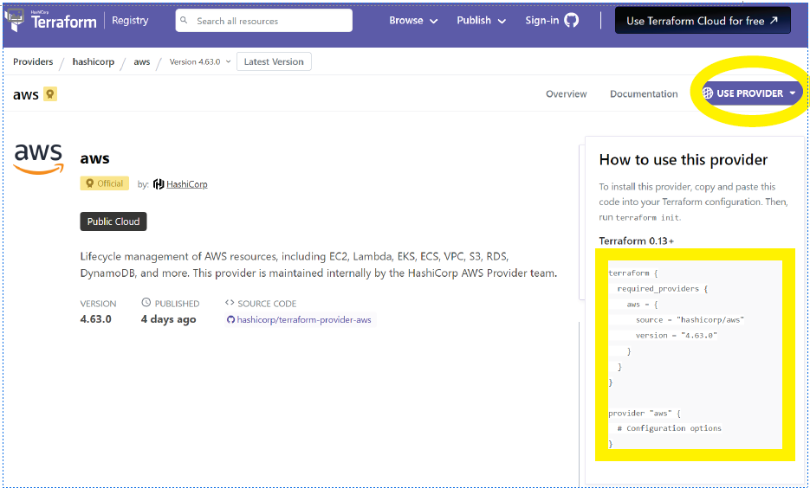
Providers

Slide 43
providers.tf
terraform {
required_providers {
aws = {
source = "hashicorp/aws"
version = "5.17.0"
}
}
required_version = "~> 1.5.7"
}
provider "aws" {
}

Slide 44
Variables
Recycling your code with

Slide 45
variables.tf
Original
resource "aws_subnet" "example" {
cidr_block = “us-east-1a”
}
Create the Variable
variable "availability_zone" {
description = "The availability zone"
type = string
default = "us-east-1a"
}
Add the Variable
resource "aws_subnet" "example" {
vpc_id = aws_vpc.example.id
cidr_block = var.subnet_cidr_block
availability_zone = var.availability_zone
}

Slide 46
Variable Type
Add the Type
variable "availability_zone" {
description = "The availability zone"
type = string
default = "us-east-1a"
}
variable "sg_cidr_blocks_allow_ssh" {
description = "The CIDR blocks of the security group"
type = list(string)
default = ["161.28.24.210/32"]
}

Slide 47
Variables Lab
https://github.com/towerindustries/saintcon23/tree/main/moderate_terraform

Slide 48
Locals

Slide 49
Locals
locals {
name = "dev-amazon2023"
owner = "utahsaint"
environment = "dev"
terraform_code = "advanced_terraform_v2"
}
locals {
common_tags = {
Name = local.name
Owner = local.owner
Environment = local.environment
Terraform = local.terraform_code
}
}
resource "aws_instance" "example" {
tags = local.common_tags
}

Slide 50
Creating Variables
Create Variables.tf
Add Variables
variable "availability_zone"
variable "cidr_block"
variable "subnet_cidr_block"
variable "sg_cidr_blocks_allow_ssh"
variable "sg_cidr_blocks_allow_http"
variable "sg_cidr_blocks_allow_https"
variable "ami_id"
variable "instance_type"
variable "iam_instance_profile"
variable "key_name"
variable "volume_size"
variable "volume_type"

Slide 51
Update main.tf
Edit main.tf
resource "aws_subnet" "example"
cidr_block = var.subnet_cidr_block
availability_zone = var.availability_zone
resource "aws_security_group" "example"
cidr_blocks = var.sg_cidr_blocks_allow_ssh
cidr_blocks = var.sg_cidr_blocks_allow_http
cidr_blocks = var.sg_cidr_blocks_allow_https
resource "aws_instance" "example"
instance_type = var.instance_type
iam_instance_profile = var.iam_instance_profile
key_name = var.key_name
volume_size = var.volume_size
volume_type = var.volume_type

Slide 52
.tfvars
terraform

Slide 53
terraform.tfvars
Create the Defaults
availability_zone = "us-east-1a"
sg_cidr_blocks_allow_ssh = [“161.28.24.210/32"]
sg_cidr_blocks_allow_http = ["161.28.24.210/32"]
sg_cidr_blocks_allow_https = ["161.28.24.210/32"]
instance_type = "t2.micro"
key_name = "dev-example-key"
volume_size = "30"
volume_type = "gp3"

Slide 54
Variable Extras
Why can we not use a variable for vpc_id?
Legacy Variables
"${var.prefix}${count.index}“
You can use tfvars or not.

Slide 55

Data

Slide 56
CLI Search for an AMI
aws ec2 describe-images \
--region us-east-1 \
--image-ids ami-0779b302ed007c203
aws ec2 describe-images \
--region us-east-1 \
--image-ids ami-054aaceda83e053ee
--owners amazon

Slide 57
Data
data "aws_ami" "latest_amazon_linux_2" {
most_recent = true
filter {
name = "name"
values = ["al2023-ami-minimal-2023*"]
}
filter {
name = "owner-id"
values = ["137112412989"]
}
filter {
name = "architecture"
values = ["x86_64"]
}
output "latest_amazon_linux_2_ami_id" {
value = data.aws_ami.latest_amazon_linux_2.id
}

Slide 58
Data and Locals Lab
https://github.com/towerindustries/saintcon23/tree/main/moderate_terraform/data_and_locals

Slide 59
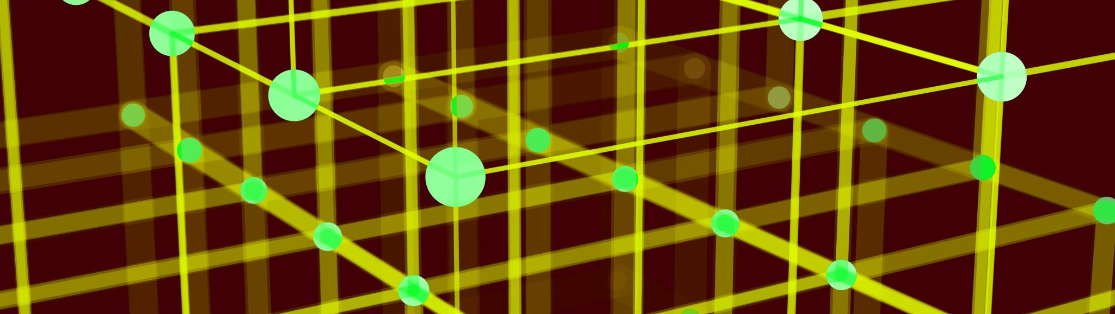
Advanced
Now you think you are a programmer

Slide 60
Agenda – Advanced TF
I will walk through the code and then hands on.
Remote State Files
Advanced Data
Notes:
A terraform provider is a plugin that allows terraform to interact with a cloud provider. They also have plugins for Vsphere, SaaS, and other APIs.
We grab this section from the terraform providers webpage. Just search terraform providers and click on azure.
Sometimes the version will change and may change the whole syntax and break your stuff. It happened to me while I was writing this presentation. The way security groups are done changed on me.
An example of a Feature is “prevent_deletion_if_contains_resources = false” This allows me to delete a resource group even if it has stuff in it. Sometimes a hard disk doesn’t get deleted because I configured the VM wrong.

Slide 61
Remote State Configuration
resource "aws_s3_bucket" "terraform_state" {
bucket = "terraform-stored-state"
# Prevent accidental deletion of this S3 bucket
lifecycle {
prevent_destroy = true
}
}
resource "aws_s3_bucket_versioning" "enabled" {
bucket = aws_s3_bucket.terraform_state.id
versioning_configuration {
status = "Enabled"
}
}
resource "aws_s3_bucket_server_side_encryption_configuration" "default" {
bucket = aws_s3_bucket.terraform_state.id
rule {
apply_server_side_encryption_by_default {
sse_algorithm = "AES256"
}
}
}
resource "aws_s3_bucket_public_access_block" "public_access" {
bucket = aws_s3_bucket.terraform_state.id
block_public_acls = true
block_public_policy = true
ignore_public_acls = true
restrict_public_buckets = true
}
resource "aws_dynamodb_table" "terraform_locks" {
name = "terraform-stored-state"
billing_mode = "PAY_PER_REQUEST"
hash_key = "LockID"
attribute {
name = "LockID"
type = "S"
}
}

Slide 62
Remote State Lab
https://github.com/towerindustries/saintcon23/tree/main/advanced_terraform/remote_state

Slide 63

Modules

Slide 64
Modules Lab
https://github.com/towerindustries/saintcon23/tree/main/advanced_terraform/intro_to_modules

Slide 65
Modules
Best Practices
Name Module Repo – terraform-cloudprovider-modulename
terraform-aws-s3-webapp
Release Tags
1.0.0
Module versioning in main.tf
Module “s3-webapp” { name = var.name version = “1.0.0” }
https://github.com/terraform-aws-modules
Required and Optional Arguments

Slide 66

CI/CD Pipelining

Slide 67

GitHub
Moderately Advanced

Slide 68
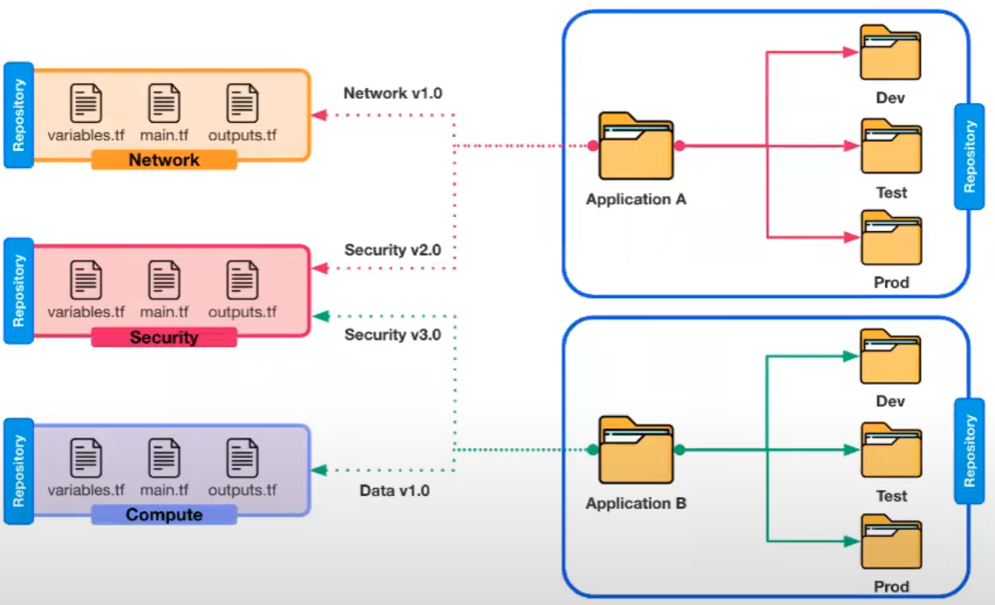
Multi-Repo
Self service on shared modules
Module versioning with release tagging
Individual repos allow for stricter RBAC
Blast Radius reduced to individual repos

Slide 69
iam_instance_profiles

Slide 70
Custom Validation Rules

Slide 71
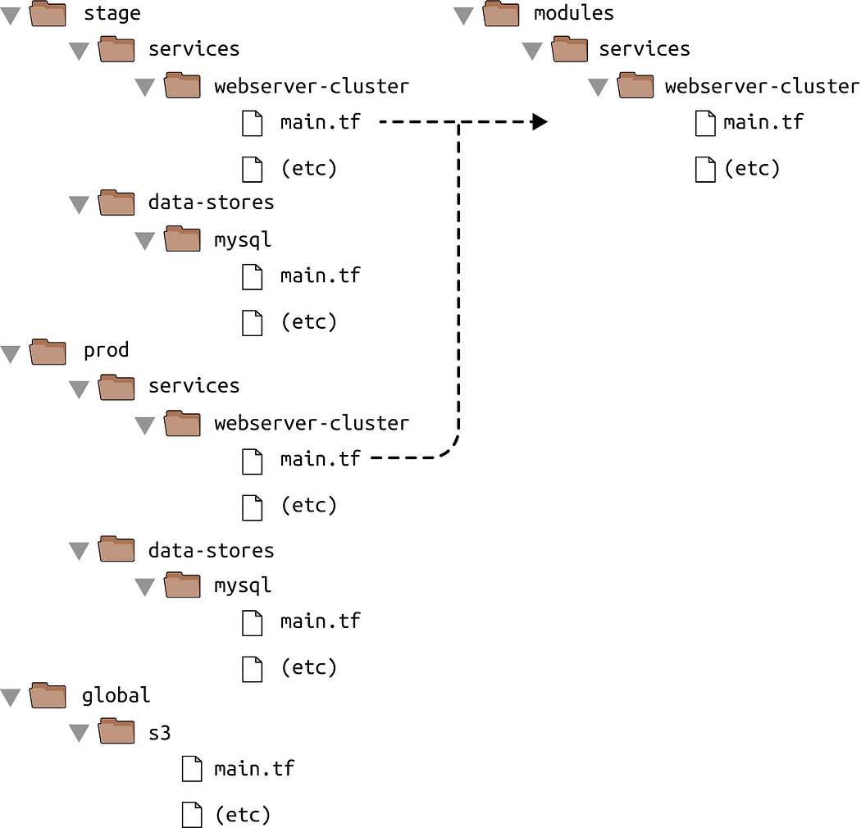

Slide 72
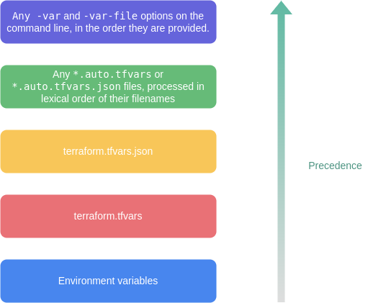
Variable Loading Precedence

Slide 73

Terraform Cloud

Slide 74
Custom Validation Rules
https://developer.hashicorp.com/terraform/language/values/variables

Slide 75
Workloads

